Slide 1
VAEs for collaborating during design thinking sessions
Augmenting brainstorming during partner meetings
Yield integrate ideas from team members & jointly visualize them

Slide 2
Augmented Human Imagination Research for Design thinking customer workshops Class Conditional generative models (CVAE)
Vision: In a design thinking session, you and customer sit together & ideate. Design thinking methodology encourages the team to come out with 100’s of fast rapid paper prototypes during a workshop.
Can digital assist you at the next design thinking workshop with your client? Welcome to Augmented Human Imagination Research
Expected Impact: Future of Consulting, Client partner meetings, Design thinking workshops, Designing an Interactive jointly with customers

Slide 3
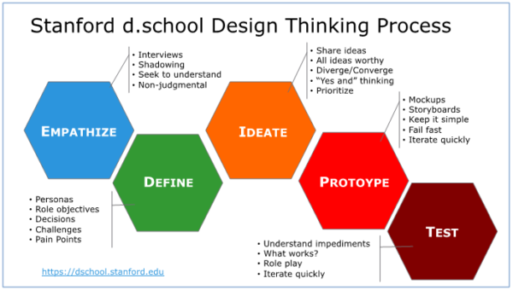
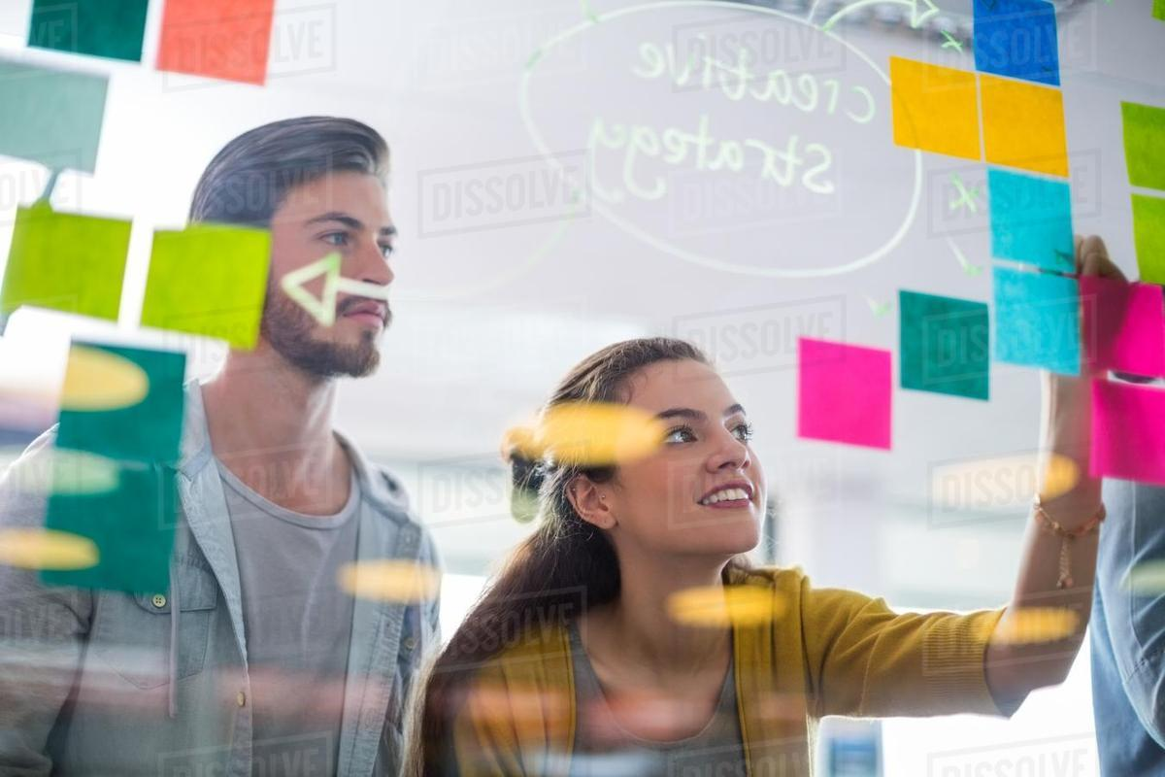
Co-imagining (Express your ideas using Conditional VAE)
Scenario: Given an collection of BWM 8 & Ford X designs, can you co-imagine new designs

Slide 4
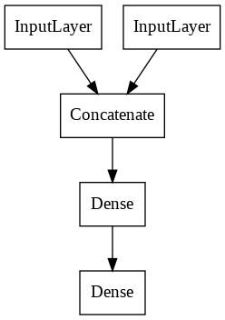
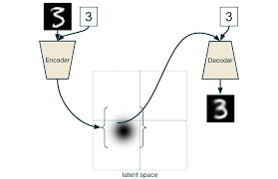
Expressing your idea during IDEATION phase: “what you think, just communicate it” Express your ideas using Conditional VAE
I want designs to be like this ..
Rapidly Imagined ideas
Here are the variations I am looking for..

Slide 5
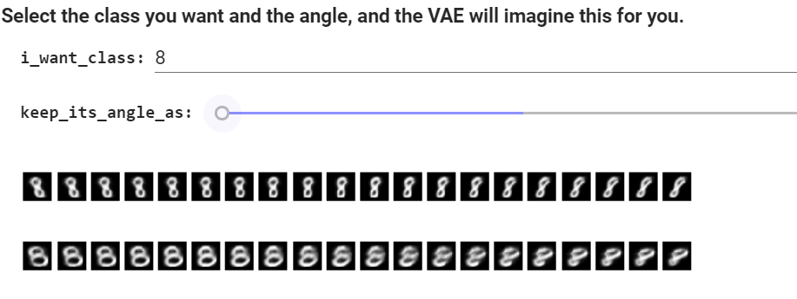
How it works for the user
I want designs to be like this ..
Here are the variations I am looking for..

Slide 6
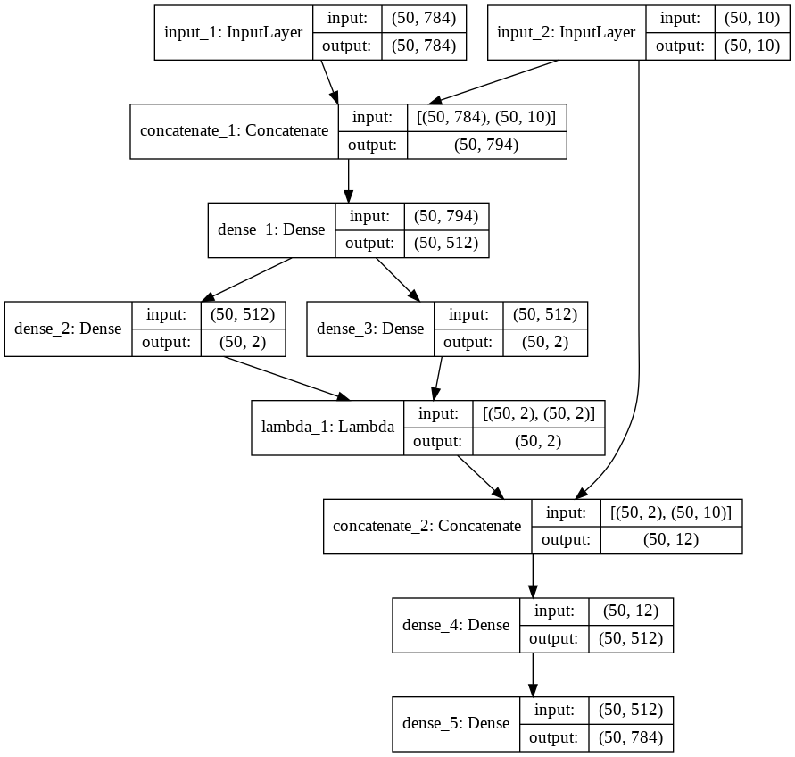
CVAE network

Slide 7
Expressing your idea during IDEATION phase: “what you think, just communicate it” Express your ideas using Conditional VAE
I want designs to be like this ..
Rapidly Imagined ideas
Here are the variations I am looking for..

Slide 8
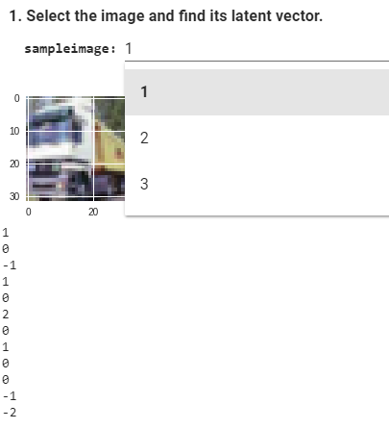

Slide 9
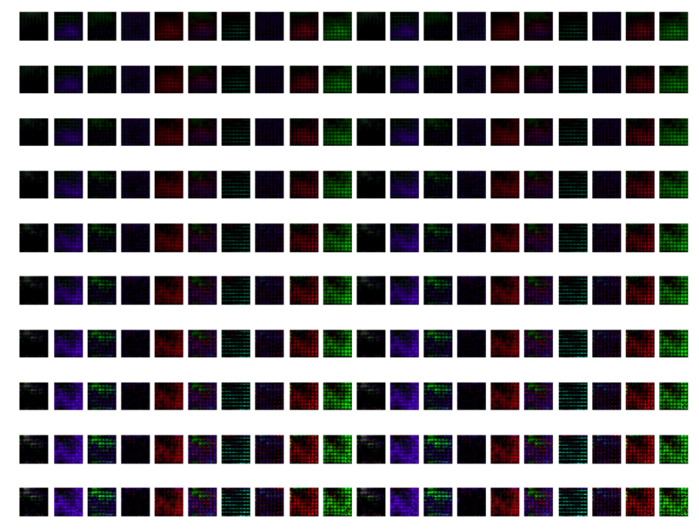
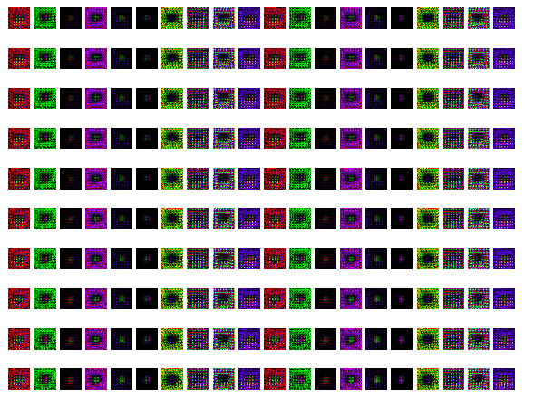

Slide 10
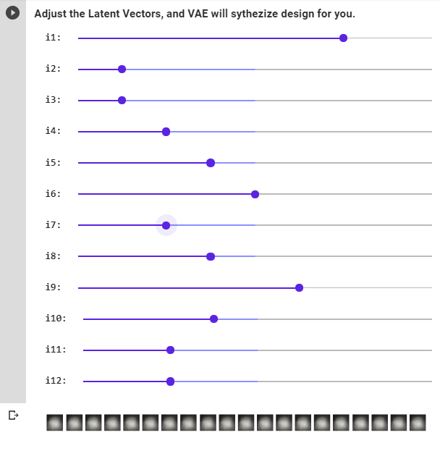

Slide 11
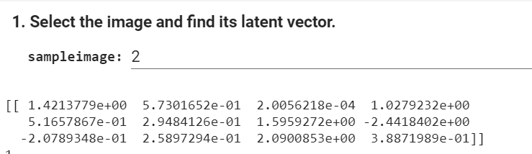

Slide 12
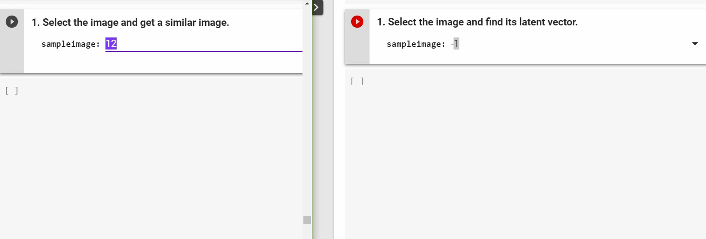
4096
6

Slide 13
“To know customer’s heart is a miracle to the success of any engagement”

